Slide 1
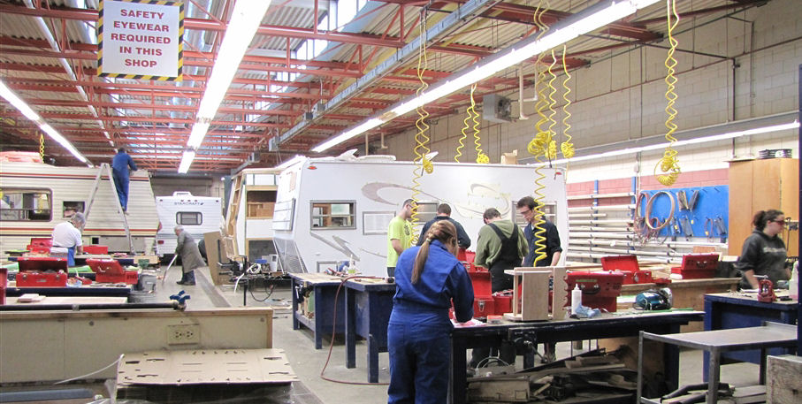
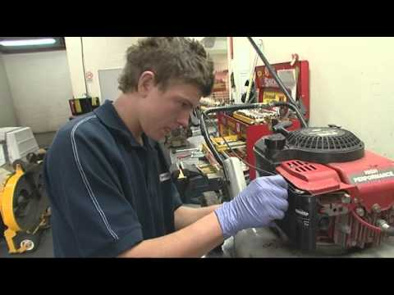
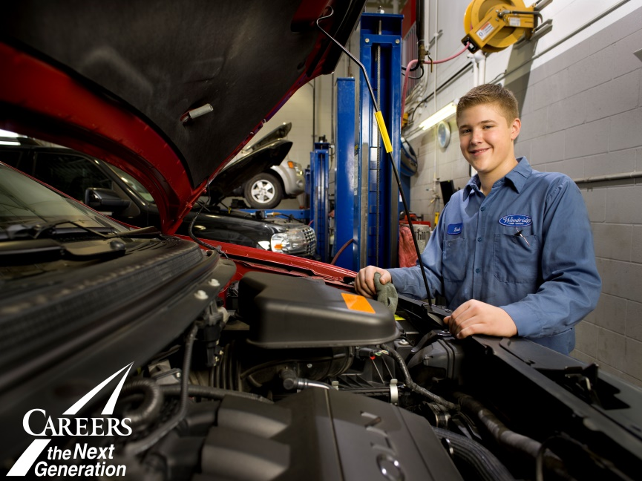
Automotive/ Mechanical Trade Options
Automotive Service Tech
Heavy Equipment Tech
RV Tech
Motorcycle Mechanic
Agricultural Equipment Tech
Auto Body Tech
Outdoor Power Equipment Tech
Parts Tech
Notes:
Local needs are to be community driven.
Meeting local needs through local and sustainable efforts.
CAREERS is a facilitator and catalyst.
CAREERS beginnings….
The Challenge
The Vision
Partnership with Alberta Chamber of Resources
Findings and ‘Go Forward’
From Pilot to Foundation
Key support pillars: Industry, Government,
Education, Community
CAREERS: The Next Generation Private/Public Partnership
Our Team:
Established in 1997
35 of the Best
Alberta-based
Our $$$:
45% Industry
55% Government
Not-for-Profit (Charitable Status)
Our Board
6 Government Deputy Ministers
15 Industry – Owners/Presidents/Vice Presidents/CEO

Slide 2
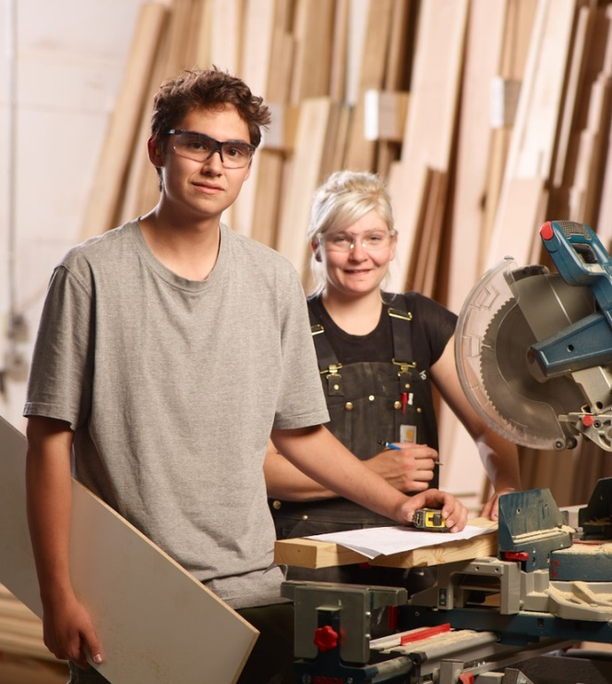
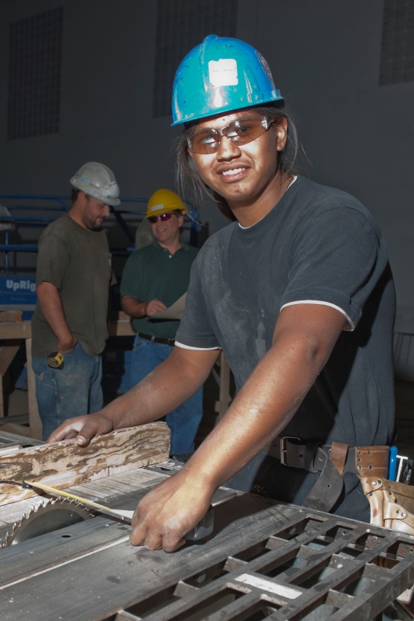
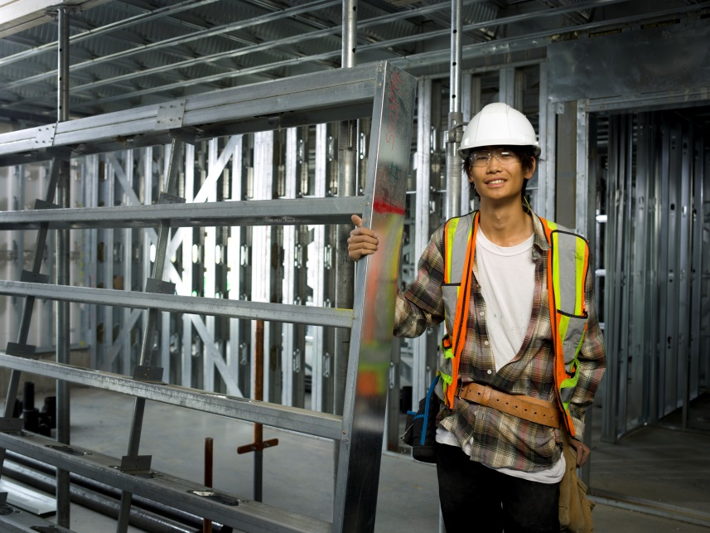
Building/Construction Trade Options
Carpenter
Concrete Finisher
Interior System Mechanic ( ISM Lather)
Floor Covering Installer
Cabinet Maker
Bricklayer
Painter
Roofer
Tile setter
Notes:
Local needs are to be community driven.
Meeting local needs through local and sustainable efforts.
CAREERS is a facilitator and catalyst.
CAREERS beginnings….
The Challenge
The Vision
Partnership with Alberta Chamber of Resources
Findings and ‘Go Forward’
From Pilot to Foundation
Key support pillars: Industry, Government,
Education, Community
CAREERS: The Next Generation Private/Public Partnership
Our Team:
Established in 1997
35 of the Best
Alberta-based
Our $$$:
45% Industry
55% Government
Not-for-Profit (Charitable Status)
Our Board
6 Government Deputy Ministers
15 Industry – Owners/Presidents/Vice Presidents/CEO

Slide 3
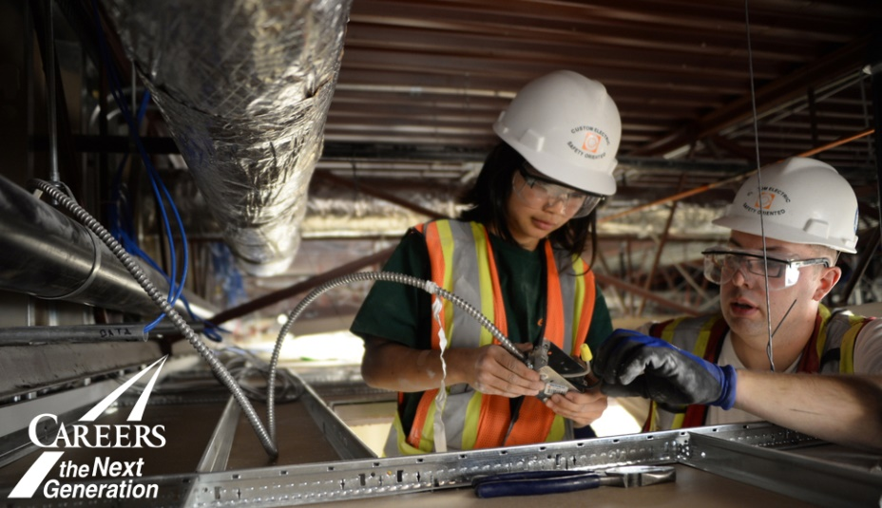
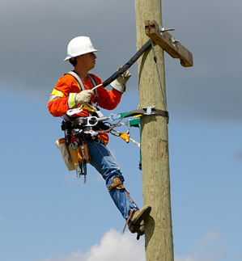
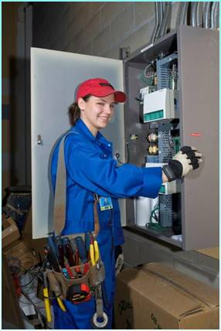
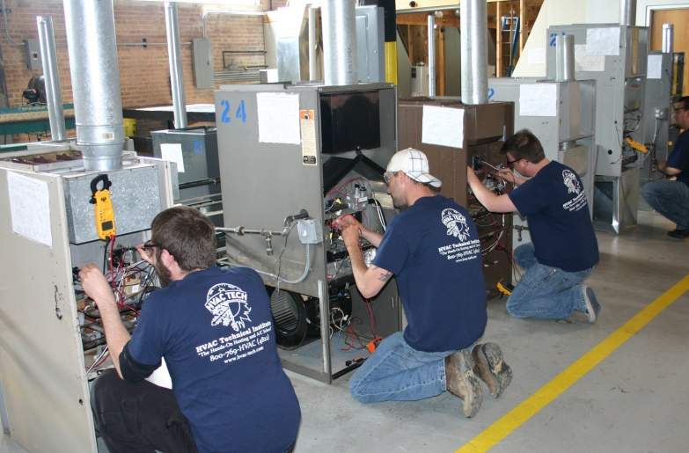
Electrical Trade Options
Electrician
Communications Tech
Refrigerator and A/C Mechanic
Instrument Tech
Power Systems Tech
Power Lineman
Electric Motor Tech
Notes:
Local needs are to be community driven.
Meeting local needs through local and sustainable efforts.
CAREERS is a facilitator and catalyst.
CAREERS beginnings….
The Challenge
The Vision
Partnership with Alberta Chamber of Resources
Findings and ‘Go Forward’
From Pilot to Foundation
Key support pillars: Industry, Government,
Education, Community
CAREERS: The Next Generation Private/Public Partnership
Our Team:
Established in 1997
35 of the Best
Alberta-based
Our $$$:
45% Industry
55% Government
Not-for-Profit (Charitable Status)
Our Board
6 Government Deputy Ministers
15 Industry – Owners/Presidents/Vice Presidents/CEO

Slide 4
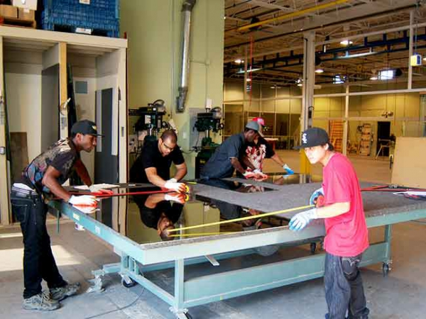
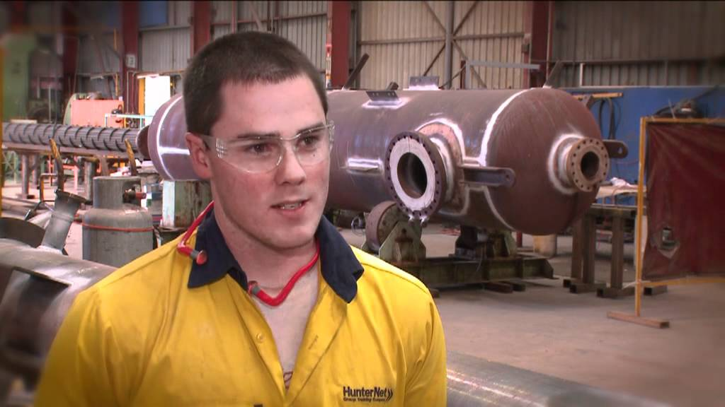
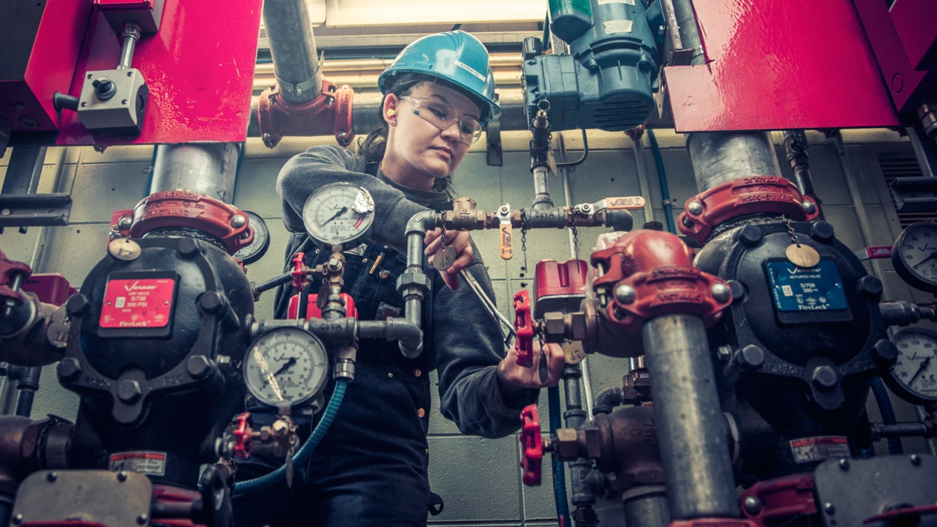
Industrial Trade Options
Insulator
Sprinkler Systems Tech
Glazier
Boilermaker
Metal Building Systems Erector
Notes:
Local needs are to be community driven.
Meeting local needs through local and sustainable efforts.
CAREERS is a facilitator and catalyst.
CAREERS beginnings….
The Challenge
The Vision
Partnership with Alberta Chamber of Resources
Findings and ‘Go Forward’
From Pilot to Foundation
Key support pillars: Industry, Government,
Education, Community
CAREERS: The Next Generation Private/Public Partnership
Our Team:
Established in 1997
35 of the Best
Alberta-based
Our $$$:
45% Industry
55% Government
Not-for-Profit (Charitable Status)
Our Board
6 Government Deputy Ministers
15 Industry – Owners/Presidents/Vice Presidents/CEO

Slide 5
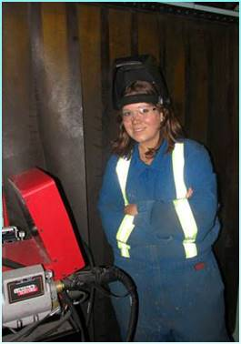
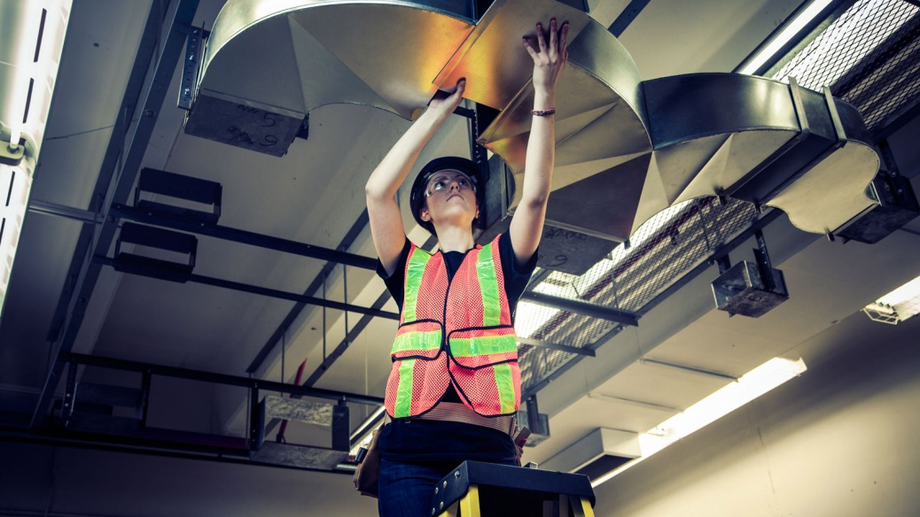
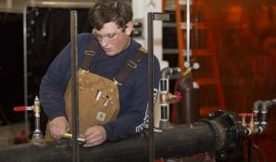
Metal and Pipe Trade Options
Welder
Steamfitter- Pipefitter
Machinist
Millwright
Sheet Metal Worker
Plumber
Structural Steel and Plate Fitter
Notes:
Local needs are to be community driven.
Meeting local needs through local and sustainable efforts.
CAREERS is a facilitator and catalyst.
CAREERS beginnings….
The Challenge
The Vision
Partnership with Alberta Chamber of Resources
Findings and ‘Go Forward’
From Pilot to Foundation
Key support pillars: Industry, Government,
Education, Community
CAREERS: The Next Generation Private/Public Partnership
Our Team:
Established in 1997
35 of the Best
Alberta-based
Our $$$:
45% Industry
55% Government
Not-for-Profit (Charitable Status)
Our Board
6 Government Deputy Ministers
15 Industry – Owners/Presidents/Vice Presidents/CEO

Slide 6
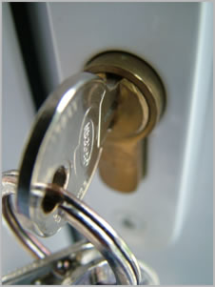
Service Trade Options
Chef
Hair Stylist
Baker
Locksmith
Notes:
Local needs are to be community driven.
Meeting local needs through local and sustainable efforts.
CAREERS is a facilitator and catalyst.
CAREERS beginnings….
The Challenge
The Vision
Partnership with Alberta Chamber of Resources
Findings and ‘Go Forward’
From Pilot to Foundation
Key support pillars: Industry, Government,
Education, Community
CAREERS: The Next Generation Private/Public Partnership
Our Team:
Established in 1997
35 of the Best
Alberta-based
Our $$$:
45% Industry
55% Government
Not-for-Profit (Charitable Status)
Our Board
6 Government Deputy Ministers
15 Industry – Owners/Presidents/Vice Presidents/CEO

